Slide 1

PULSATILE FLOW
Master Presentation

Slide 2
centrifugal pump+ controller
Plunger
External Pressure
Water collected
Air Bag
Silicone tube
pressure sensor
3D- DIC
Flow sensor
Data Acquisition system

Slide 3
IN LAST PRESENTATION-
centrifugal pump+ controller
Water Tank
Plunger
Water collected
silicone tube

Slide 4
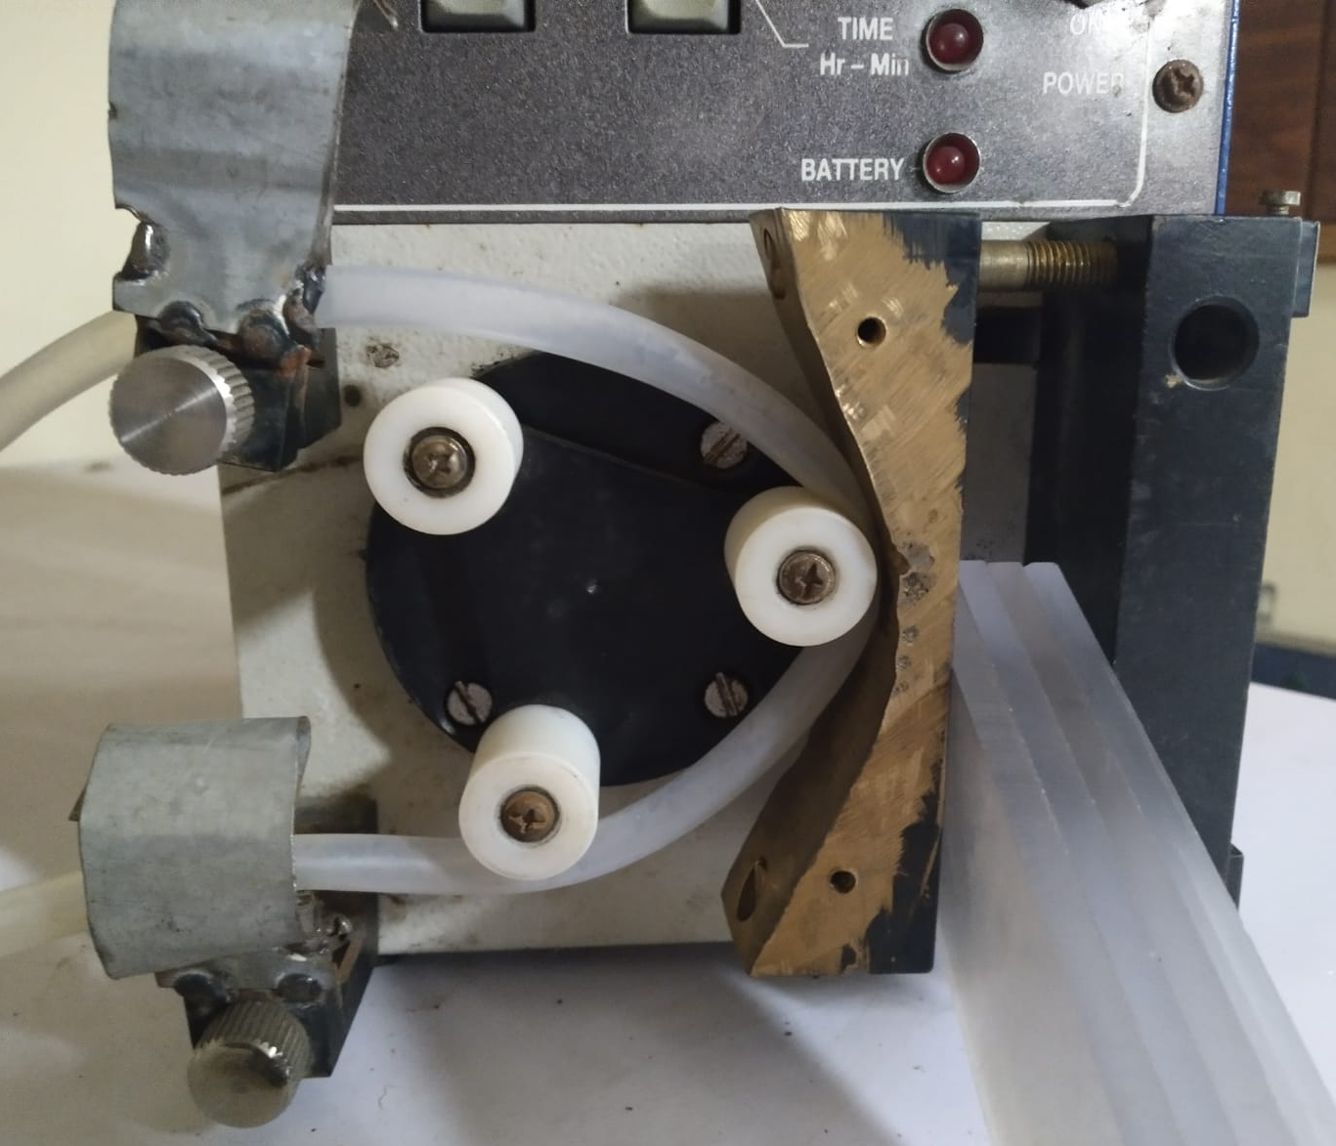
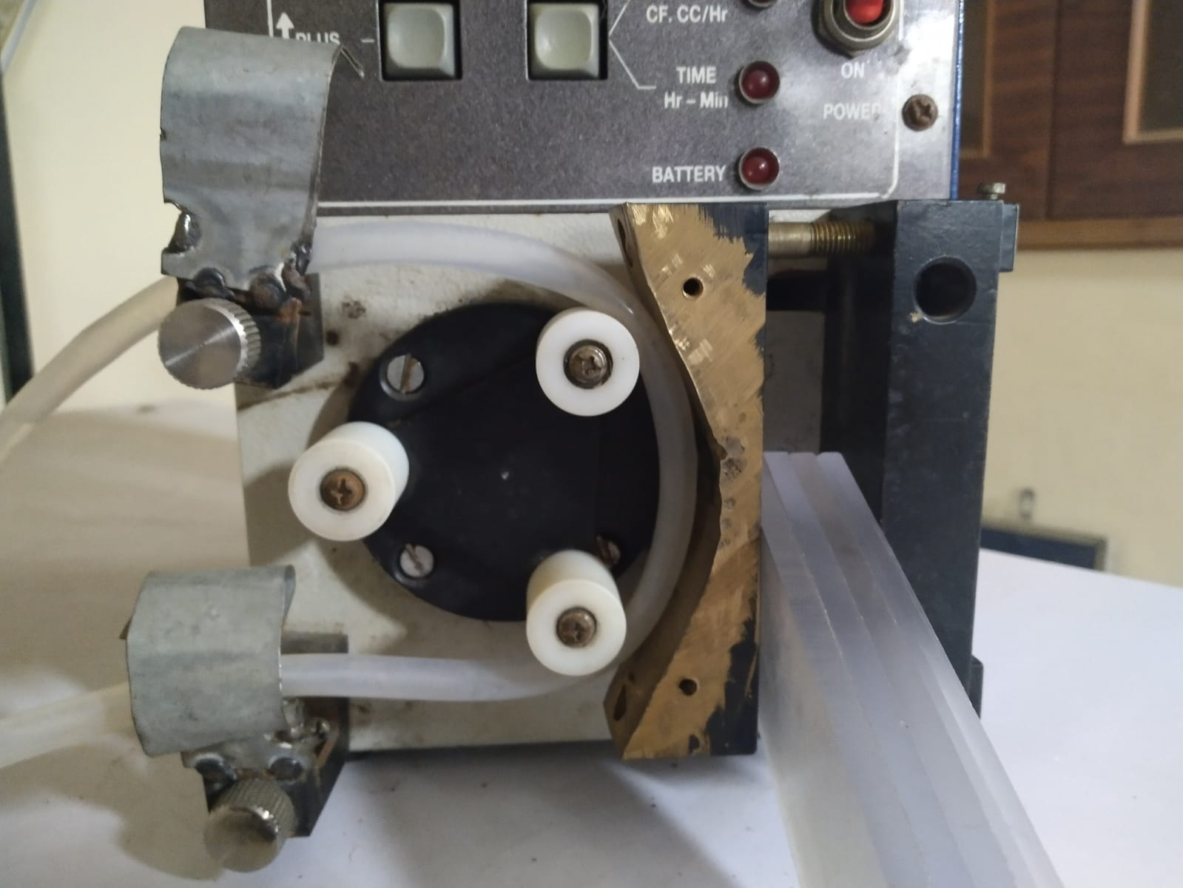
Old picture of pump

Slide 5
Head drawing
Material- aluminium
Tolerance - ±0.5mm

Slide 6
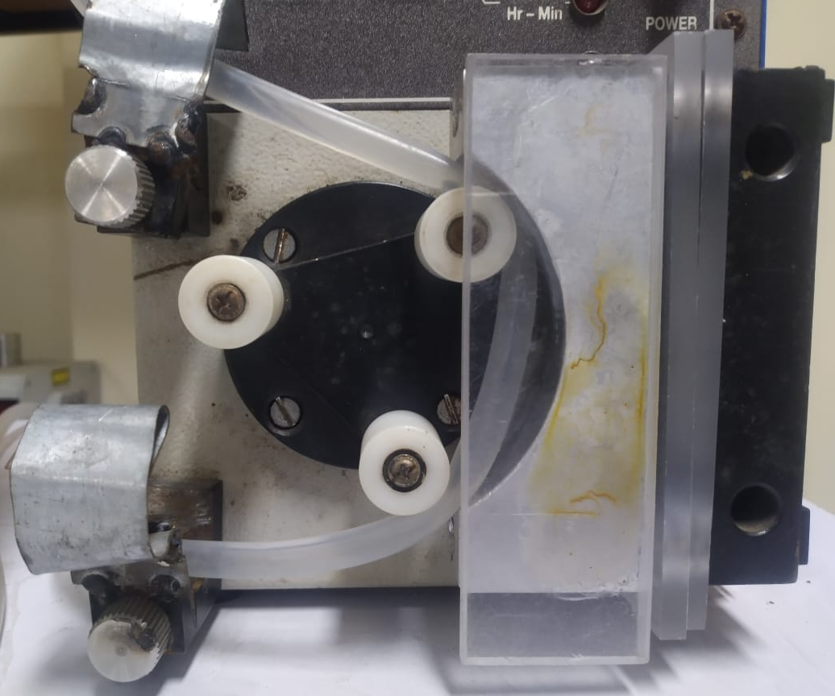
SPECIFICATIONS
Inner diameter- 6mm
Outer diameter-8mm
Flow rate- 300ml/min
Reynolds number-416
Pulse frequency-10 pulse/min

Slide 7
centrifugal pump+ controller
Plunger
External Pressure
Water collected
Air Bag
Silicone tube
pressure sensor
3D- DIC
Flow sensor
Data Acquisition system

Slide 8
Calibration of instruments-
Pressure sensor, flow sensor were calibrated.
Data Acquisition System was made using Arduino UNO.
Arduino was coded using its ide to read and give command to sensors according to calibrated values.
Arduino UNO is 10bit ADC.
Flow sensor was calibrated using beaker.
Pressure sensor was calibrated using pressure gauge and ADC relation with voltage.

Slide 9
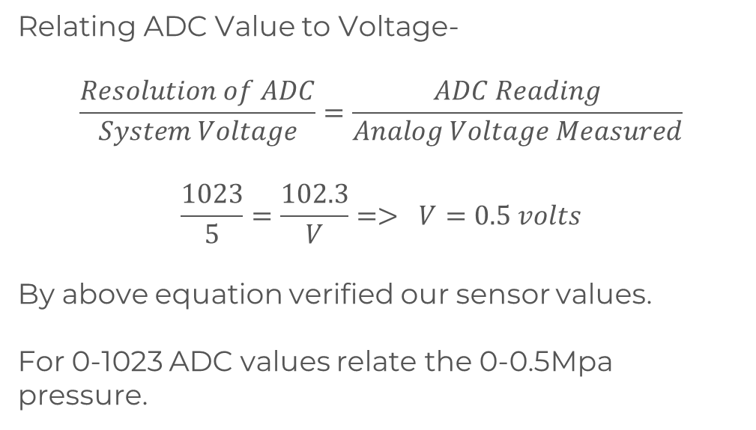
Sensor Calibration Concept-
Since Arduino is 10bit ADC(Analog to Digital Converter)-
For Pressure sensor-
Relating ADC Value to Voltage-
$$\frac{Resolution of ADC}{System Voltage}=\frac{ADC Reading}{Analog Voltage Measured}$$
$$\frac{1023}{5}=\frac{102.3}{V}=> V=0.5 volts$$
By above equation verified our sensor values.
For 0-1023 ADC values relate the 0-0.5Mpa pressure.

Slide 10
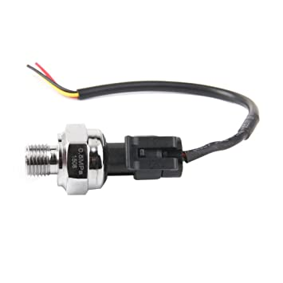
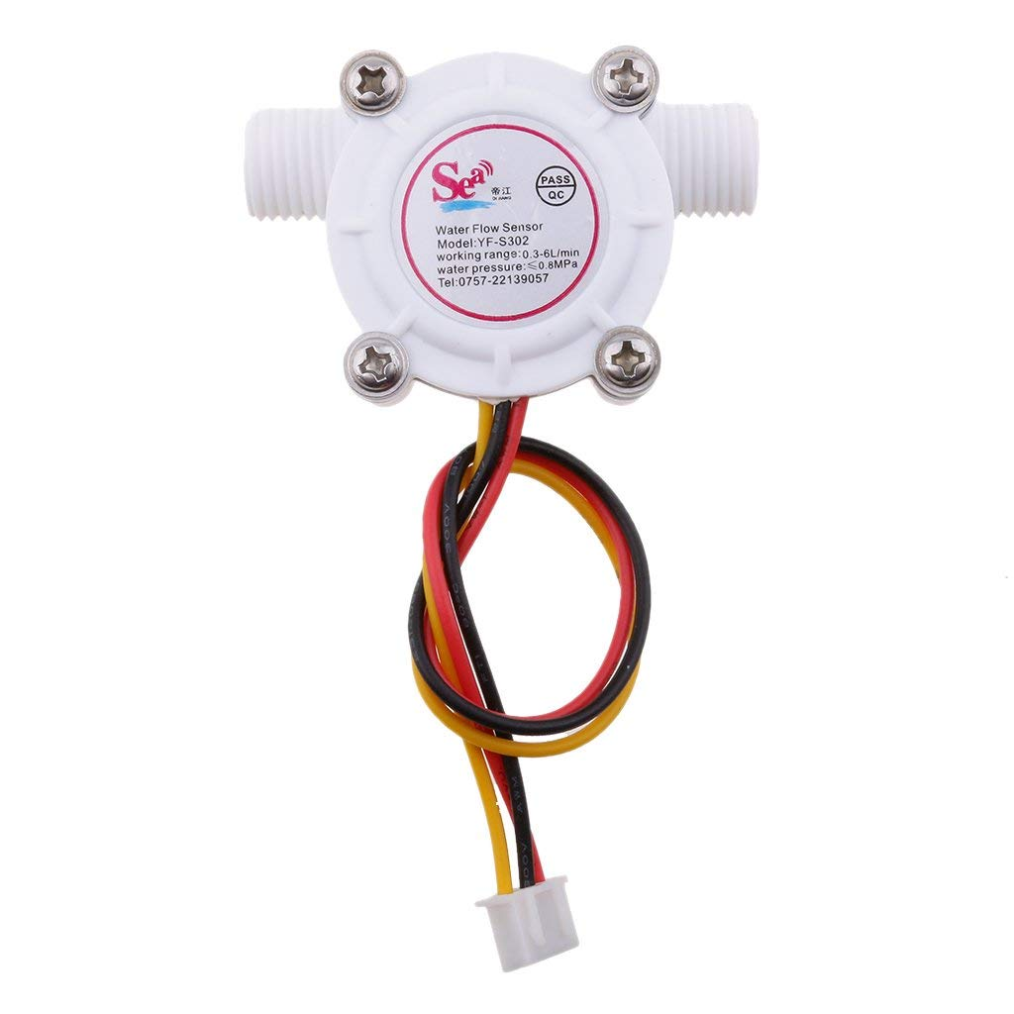
PRESSURE SENSOR AND FLOW SENSOR
Type | Analog Pressure Sensor
Sensor Type | piezoelectric sensor
Thread Size | G 1/4"
Pressure Range (MPa) | 0 – 0.5
Operating Voltage (VDC) | 5
Output Voltage (VDC) | 0.5 ~ 5
Error | 0.1% FS
Type | Digital Flow Sensor
Sensor Type | Hall effect sensor
Thread Size | G 1/4"
Flow Range (l/min) | 0 – 6
Operating Voltage (VDC) | 5
Output Voltage (VDC) | 0.5 ~ 4.5
Error | 2%

Slide 11




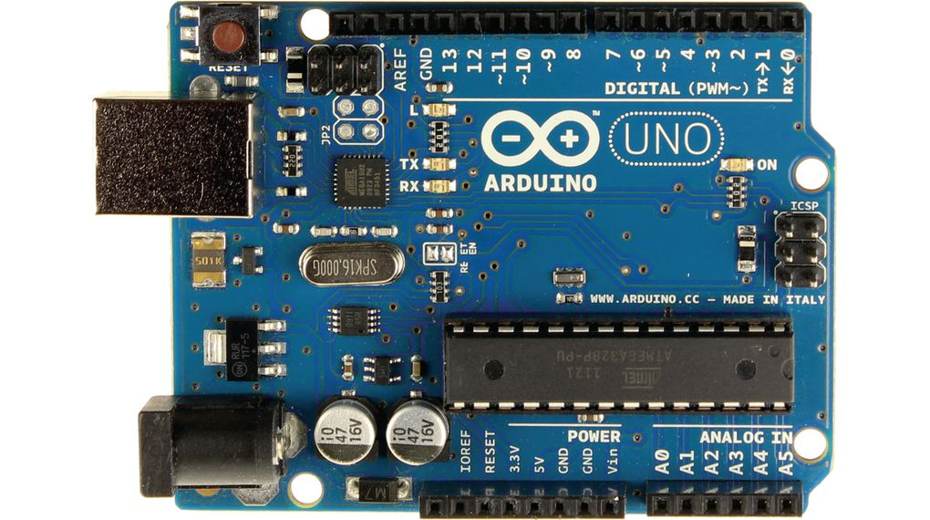
Data Acquisition System
CONNECTED TO PC
SOFTWARES USED FOR PROCESSING DATA AND CODING
ARDUINO IDE (Coding)
RESULTS-

Slide 12
FLOW WAVEFORM IN SETUP
Flow rate (ml/sec) = 3.18674 *sin (1.03332 *t +1.67248)+4.95948

Slide 13

Equations-
Flow rate (ml/sec) = 3.18674 *sin (1.03332 *t +1.67248)+4.95948
Pipe inner diameter- 6mm
Pipe outer diameter- 8mm
Area- 2.826e-5
$$m^{2}$$
Velocity (m/sec) = 0.112765 *sin (1.03332 *t +1.67248)+0.175494
$$u\left(r,t\right)=u_{s}\left(r\right)+u_{∅}(r,t)$$

Slide 14
Transparent Airbag was made-
The pressure that the bag can withstand =200mm Hg.
Airbag material thickness is 23 micron.
The Results taken are obtained by using complete elastic tube from start to end.
Acrylic box to enclose airbag incomplete.

Slide 15

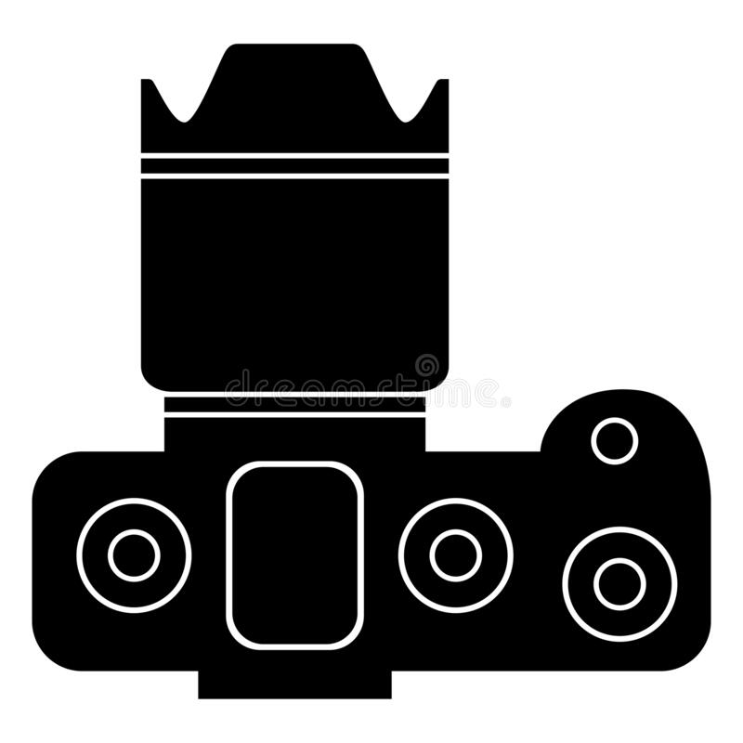

PICTURES TRANSFERED TO PC
3D Digital Image Correlation-
SOFTWARES USED FOR IMAGE PROCESSING
System Calibration
IMAGE PROCESSING
Results-
Picture captured

Slide 16
DIC Calibration-
Use pattern whose parameters are known.
Rotate the pattern at different angle and capture pictures.
Give images to the system and try to get minimum error.

